Slide 1
Fiscal Year 2026 Finances
http://finance.missouri.edu

Slide 2
Fiscal Year 2026 Budget
FUNDING SOURCES
State Appropriations Tuition & Fees Targeted Appropriations & Fees Grants & Contracts Gifts, Endowment & Investment Income “Enterprise” Operations
Total Revenue
272,742,647 672,457,684 65,545,649 479,911,771 165,918,832 3,008,915,446
$4,665,492,029
5.8% 14.4% 1.4% 10.3% 3.6% 64.5%
100%

Slide 3
“ENTERPRISE” OPERATIONS
Hospitals & Clinics University Physicians Research Reactor Athletics Residential Life Veterinary Medicine Campus Dining University Stores Parking KOMU Other (Revenue less than $10M)
$2,068,485,485 402,233,285 158,595,358 106,283,062 68,905,399 32,264,354 31,610,060 29,250,669 11,039,244 10,403,290 89,845,290
68.7% 13.4% 5.3% 3.5% 2.3% 1.1% 1.1% 1.0% 0.4% 0.4% 3.0%
$ 3,008,915,446
100%

Slide 4
GENERAL REVENUE ALLOCATION - GRA
General Revenue Allocation Sources
State Appropriations $273M
Tuition and Fees $668M
Overhead and F&A $100M
Total $1041M

Slide 5
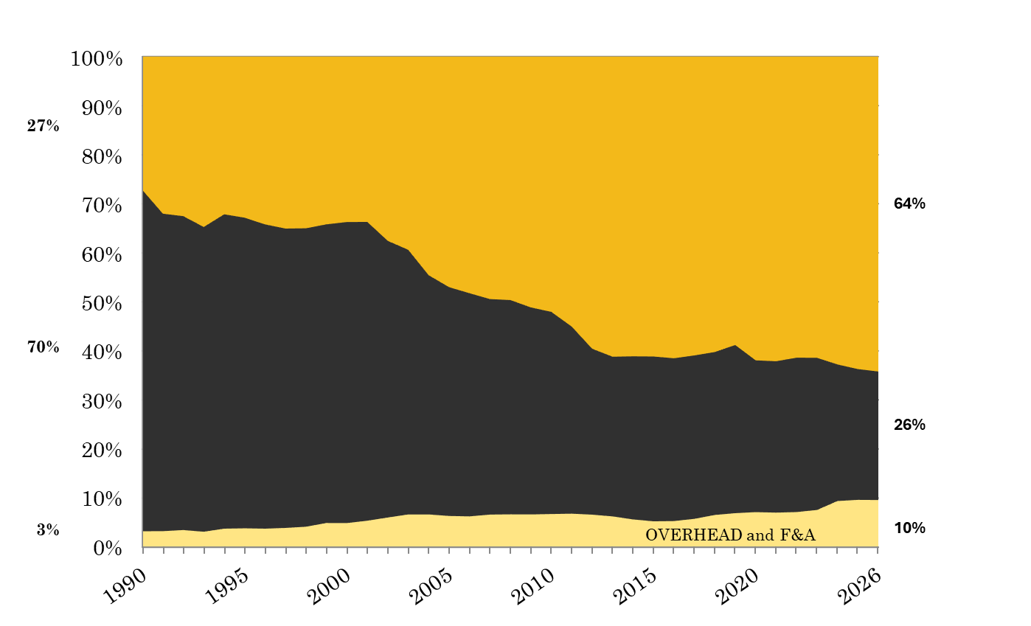
CHANGE IN GENERAL OPERATING FUNDING SOURCES
TUITION & FEES
STATE SUPPORT

Slide 6
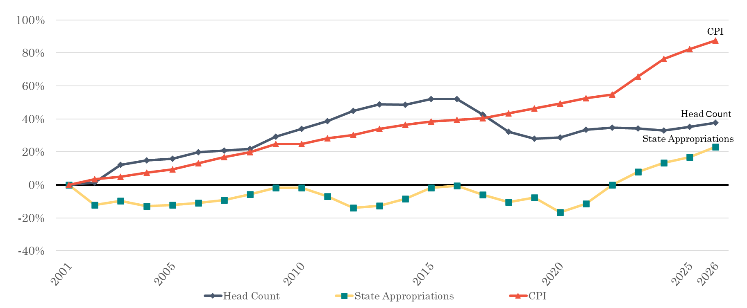
REVENUE DRIVERS FY2001 – FY2026

Slide 7

STATE SUPPORT FOR HIGHER EDUCATION
Appropriation per Capita Ranking
40
4
12
14
46
29
19
41
25
*Information obtained from the Grapevine Report publish by Illinois State University, FY2025 National Comparison

Slide 8
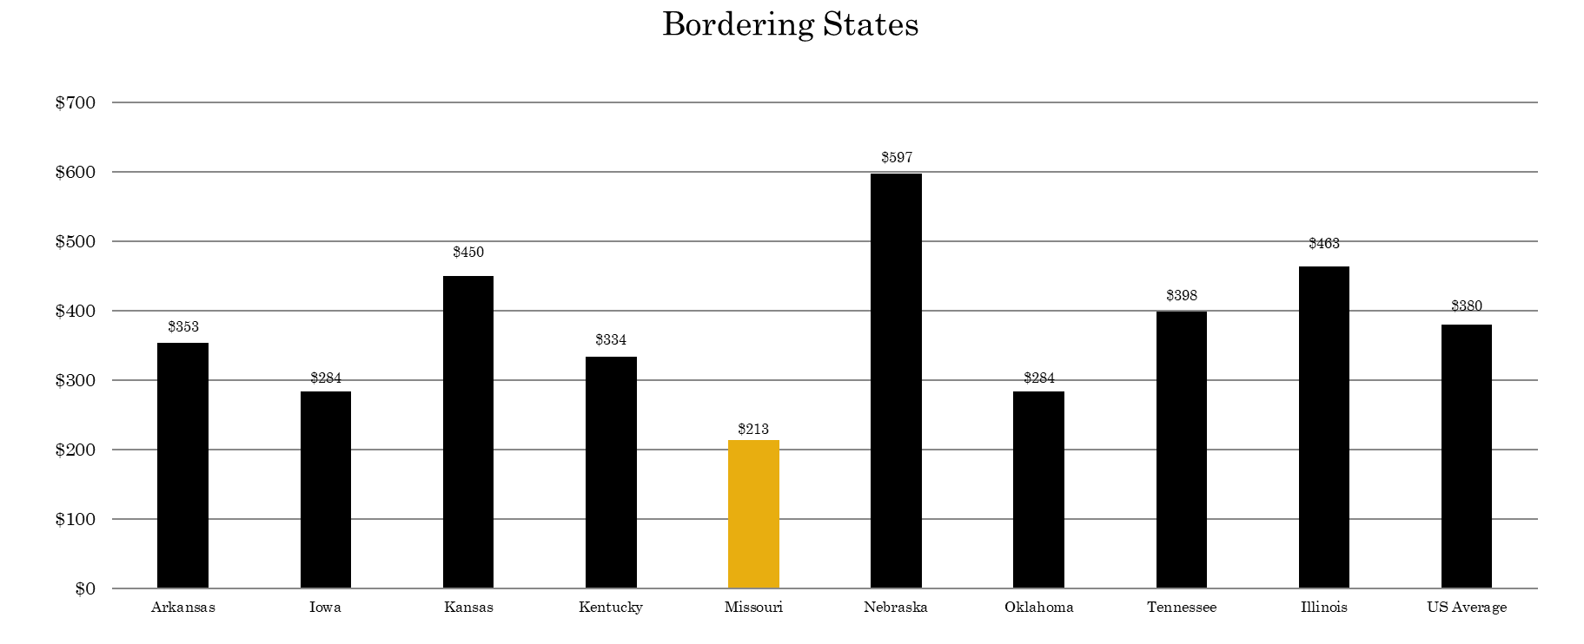
FY2025 STATE APPROPRIATIONS FOR HIGHER ED PER CAPITA

Slide 9
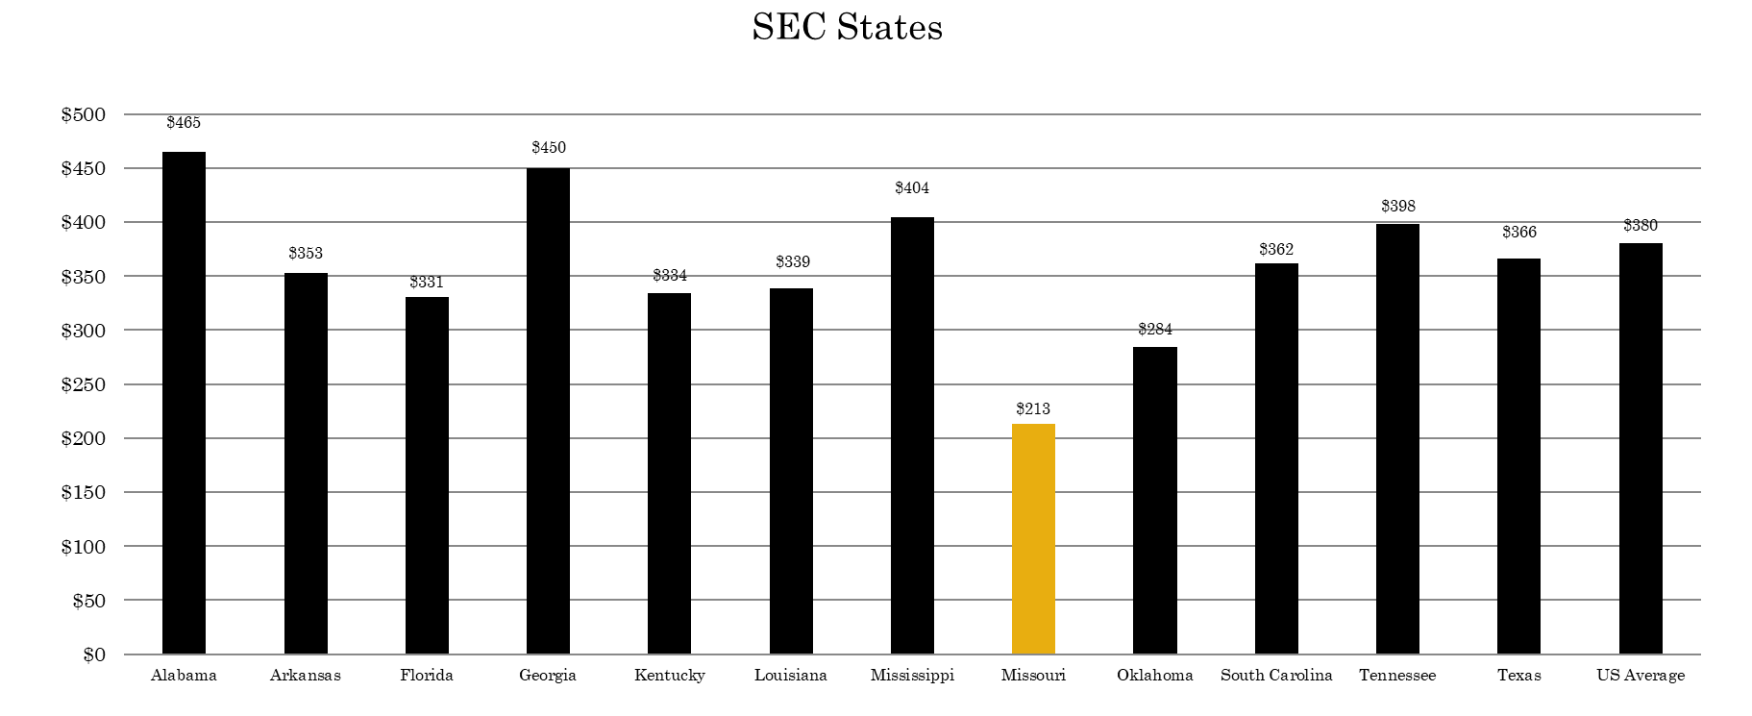
FY2025 STATE APPROPRIATIONS FOR HIGHER ED PER CAPITA
Notes:
File: SHEEO_Grapevine_FY25_Tables
CBUDG>FiscalYear>FY 2026> FY26 Presentations_Surveys>FY25 Grapevine

