Slide 1
FY 21 BUDGET Go-Live

Slide 2
FY 21 Budgeting
System ready February 3
SALPLN seeding based on January 26 JED
No changes to forms or calculations
Anticipate benefit rate changes (final #s pending)
Campus – Per Person from $10,000 to $10,500 and Pay Based from 14.22% to 14.96%
Social Security Maximum increases to $137,700 making budget limit $8,537
Slight change to security form to better identify user alias for security set up

Slide 3
Reminders and Tips
Browsers needed – Internet Explorer 11 and Firefox 45+ ESR
New employees do not appear in SALPLN until the JED setup is complete
Manage JED vs Budget forms can be used to catch salary/position updates throughout the process
Manual SALPLN adds for positions and chartfields will be processed on Tuesday and Thursdays

Slide 4
Reminders and Tips
Budget transfers are not seeded in data to start but forms are available to download FY 20 information, edit, and upload.
Using Smart View for some entry such as reviewing numerous rows in SALPLN might be helpful for fetching issues.
FINPLN forms exist other than 1.0 that might be helpful in some cases with data organized in different views for entry

Slide 5
Reporting Changes
Researching a new portal page in Cognos that displays more reports on the page and saves steps from opening folders

Slide 6
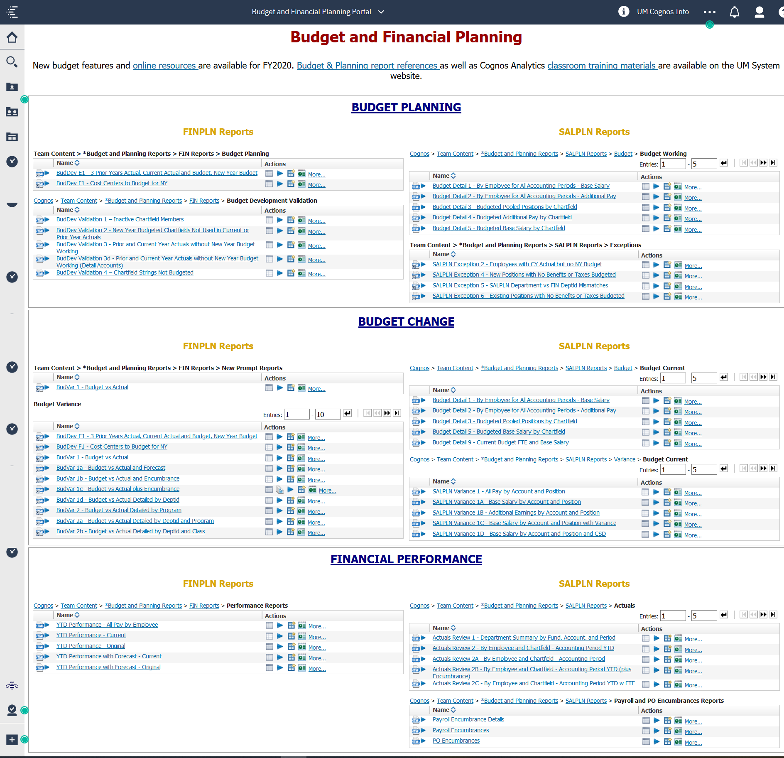

Slide 7
More Info
More detailed information on these items will be shared later this month

