Slide 1
Budget and Allocation Process
October 2022

Slide 2
GOALS FOR THESE MEETINGS
Share information
Answer questions
Continuous Improvement
Agenda
Overall Picture
College level information
  Changes to GRA – Base Process
  Changes to allocations – Other factors
Budget Cycle

Slide 3
Fiscal Year 2023 Budget
FUNDING SOURCES
Operating Fund
Targeted Appropriations & Fees
Grants & Contracts
Gifts, Endowment & Investment Income
Enterprise Operations
Total Revenue
790,012,404
77,178,334
275,339,917
125,570,184
2,004,029,645
$3,272,130,473
24.1%
2.4%
8.4%
3.8%
61.2%
100%

Slide 4
“ENTERPRISE OPERATIONS”
Hospitals & Clinics
University Physicians
Athletics
Residential Life
Research Reactor
University Stores
Veterinary Medicine
Campus Dining
KOMU
Agriculture
Enrollment Management
Parking
Mizzou Academy
Other
$1,373,721,599
266,463,113
76,247,858
60,390,406
36,837,807
33,211,965
28,313,125
24,770,892
12,582,411
11,459,990
10,172,085
7,131,141
5,270,153
57,457,100
68.5%
13.3%
3.8%
3.0%
1.8%
1.7%
1.4%
1.2%
0.6%
0.6%
0.5%
0.4%
0.3%
2.9%
$2,004,029,645
100%

Slide 5
GENERAL OPERATING SOURCES
Operating Fund (General Revenue Allocation – GRA)
State Appropriations $234M
Tuition and Fees $495M
Overhead (F&A and Inst. Support) $61M
Total $790M

Slide 6
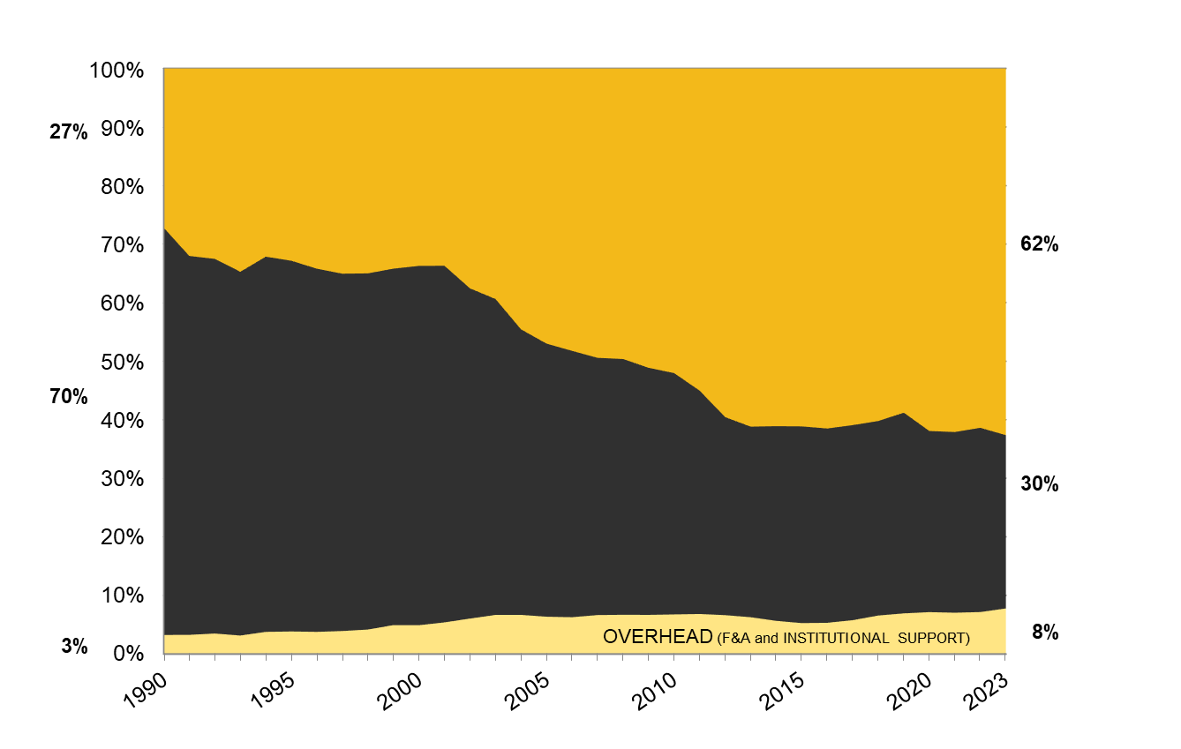
CHANGE IN GENERAL OPERATING FUNDING SOURCES
TUITION & FEES
STATE SUPPORT

Slide 7
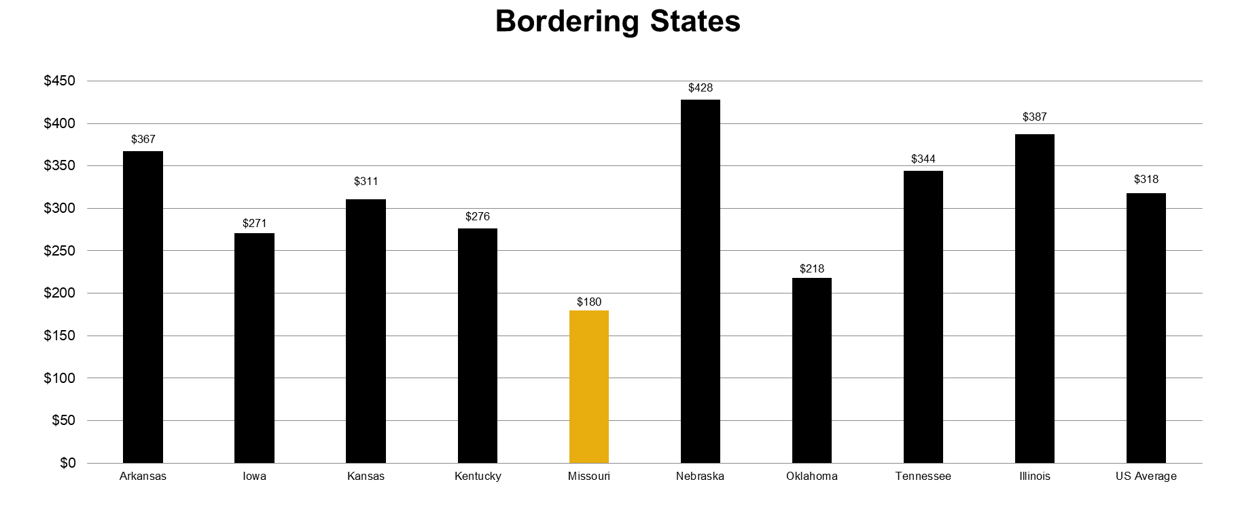
FY2022 STATE APPROPRIATIONS FOR HIGHER ED
PER CAPITA

Slide 8

STATE SUPPORT FOR HIGHER EDUCATION
Appropriation per Capita Ranking
33
6
10
19
47
31
16
42
13
*Information obtained from the Grapevine Report publish by Illinois State University, FY2022 National Comparison
Notes:
State Rank
New Hampshire 50
Pennsylvania 49
Arizona 48
Missouri 47
Vermont 46
Rhode Island 45
Ohio 44
Colorado 43
Michigan 41.5
Oklahoma 41.5
Nevada 40
Maine 39
Montana 38
Oregon 37
Delaware 36
South Carolina 35
Florida 34
Iowa 32.5
Massachusetts 32.5
Kentucky 31
Indiana 30
New Jersey 29
Louisiana 28
Wisconsin 27
Idaho 26
Texas 25
West Virginia 24
South Dakota 23
New York 22
Virginia 21
Minnesota 20
Kansas 19
Washington 18
Mississippi 17
Tennessee 16
Georgia 15
Maryland 14
Arkansas 13
Connecticut 12
Alabama 11
Illinois 10
Utah 9
Alaska 8
North Carolina 7
Nebraska 6
New Mexico 5
North Dakota 4
California 3
Hawaii 2
Wyoming 1

Slide 9
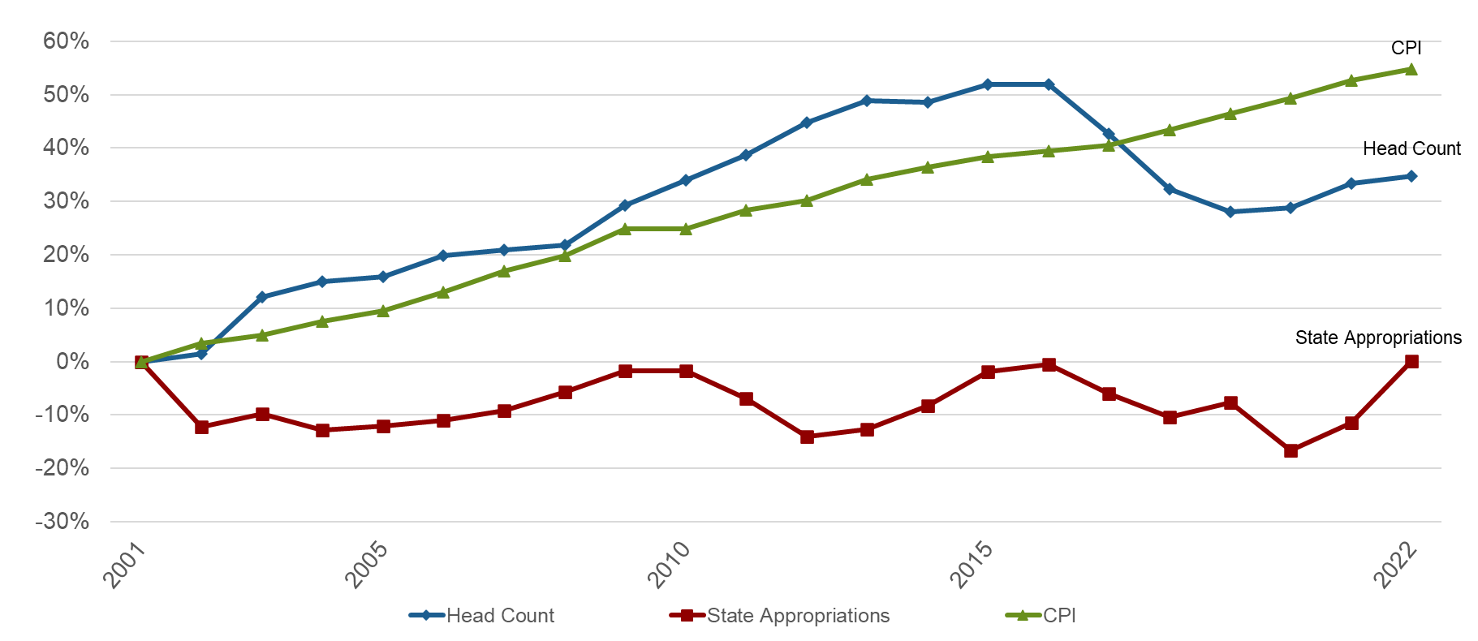
REVENUE DRIVERS
FY2001 – FY2022

Slide 10
Campus level data FY19 to FY21
Data used in determining base GRA changes
Undergraduate – Net tuition down 1%: (2.2M)
  SCH up 3.1%
  Tuition and Fees up 8.7%
  Scholarships central funded up 40.9%
Graduate – Net Tuition up 11.4%: 2M
  SCH down .8%
  Tuition and Fees up 2.2%
  Waiver costs down 6.1%
Professional – Net Tuition up 17.7%: 6.6M
  SCH up 11.7%
  Tuition and Fees up 18.5%
  Financial aid up 81.5% - to a total of less than $1M
Recovered F&A from Grants and Contracts up 10.6%: 4.2M

Slide 11
College level information – Changes to Allocations
A. Changes to GRA – Base Process
B. Changes to Allocations based on other factors

Slide 12
A. Changes to GRA – Base process
GRA FY23
Started with FY22 GRA base
Considered the following factors:
  Changes at the units in net tuition and supplemental fees.
  Trajectory of fiscal and mission-based metrics including, shared research credit, gift revenue, auxiliary revenue, grant revenue, retention and graduation rates, engagement and outreach, metrics related to IDE including proportion of URM faculty and students for every college.
  Efforts made by the colleges to reduce expenditures.
Reviewed these data in the context of the differing expectations of each of the schools in ultimately delivering on our missions
Given the volume of base cuts in recent years moved to award no base change lower than a 1% increase.
Greater numbers of positive indicators and greater levels of progress were awarded higher increases in base for the coming year.

Slide 13
Metrics
Financial Data by College/School (FY19 to FY21)
https://finance.missouri.edu/wp-content/uploads/FY23-CollegeSchool-FY19to21.pdf

Slide 14
General Revenue Allocation(GRA) - Base Process
 |  |  | Dollar
College/School/Division (CSD) | FY22 GRA | % change | Change
College of Arts & Science | 80,156,226 | 4% | 3,214,049
College of Ag, Food & Nat Resources | 31,168,726 | 1% | 311,687
Trulaske College of Business | 22,291,618 | 3% | 668,749
College of Education & Human Dev | 18,435,523 | 5% | 921,776
College of Engineering | 29,051,721 | 2% | 581,034
School of Health Professions | 17,541,456 | 5% | 877,073
Missouri School of Journalism | 12,901,304 | 1% | 129,013
School of Law | 7,262,904 | 4% | 290,516
School of Medicine | 32,562,579 | 5% | 1,605,802
Sinclair School of Nursing | 7,124,437 | 5% | 356,222
College of Veterinary Medicine | 15,442,631 | 5% | 743,910
Total | 273,123,141 | 3.60% | 9,699,831
Base GRA changes were established in January and were set between 1 and 5% based on mission and financial performance by the schools and colleges.

Slide 15
B. Changes to Allocations based on other factors
Distribution of funds to support tuition cost for Graduate Students on Assistantships
Merit increase program
Faculty promotions - raise funds
Earmarked state funds
Reorganizations
Discrete fees under enrollment management moved into GRA
Change in Delivery of service methodology (IT)
MizzouForward! Investments

Slide 16
MizzouForward! Faculty Hiring
Hires through October 7, 2022

Slide 17
MizzouForward! Student Success projects & Advising support

Slide 18
General Revenue Allocation(GRA) Change FY22 to FY23
Change in GRA from one year to the next includes base adjustments for mission and financial performance, merit increase funds, faculty promotion increases, strategic mission investments, and reorganization movement of funds.
Notes:
FY23 General Revenue Allocations General revenue allocation (GRA) is the base budget provided to each College/School/Division (CSD) for operations for the year. GRA is comprised of tuition and fees, state appropriation, and collected facilities and administration (overhead) costs on grants and from auxiliaries. Change in GRA from one year to the next includes base adjustments for mission and financial performance, merit increase funds, faculty promotion increases, strategic mission investments, and reorganization movement of funds. Most CSDs have other resources they use to carry out the full work of their organization - other sources include clinical revenue, grants and contracts, gifts, endowment income, and other auxiliary, service or miscellaneous revenues.

Slide 19
GRA change cont.
College/School/Division (CSD) | GRA FY22 | GRA Change | GRA FY23 | % Change
Information Technology (IT) | 19,298,428 | 4,036,316 | 23,334,744 | 20.92%
Provost | 57,579,084 | 12,113,616 | 69,692,700 | 21.04%
Campus Operations | 70,996,059 | 5,939,669 | 76,935,728 | 8.37%
Advancement | 3,597,276 | 156,200 | 3,753,476 | 4.34%
Chancellor | 2,851,125 | (249,078) | 2,602,047 | -8.74%
MU Extension & Engagement | 19,688,736 | 1,092,813 | 20,781,549 | 5.55%
Human Resources | 1,185,090 | 152,841 | 1,337,931 | 12.90%
Inclusion-Diversity-Equity | 2,740,036 | 214,331 | 2,954,367 | 7.82%
Research, Innovation & Impact | 19,744,020 | 2,891,841 | 22,635,861 | 14.65%
Student Affairs | 2,600,842 | 787,639 | 3,388,481 | 30.28%
Strategic Comms & Marketing | 4,763,202 | 750,960 | 5,514,162 | 15.77%
Finance & Business Services | 29,740,648 | 4,460,939 | 34,201,587 | 15.00%
Mission Support & Contingency funds | 64,093,263 | 21,083,548 | 85,176,811 | 32.90%
Total | 704,997,662 | 85,014,742 | 790,012,404 | 12.06%
Notes:
FY23 General Revenue Allocations General revenue allocation (GRA) is the base budget provided to each College/School/Division (CSD) for operations for the year. GRA is comprised of tuition and fees, state appropriation, and collected facilities and administration (overhead) costs on grants and from auxiliaries. Change in GRA from one year to the next includes base adjustments for mission and financial performance, merit increase funds, faculty promotion increases, strategic mission investments, and reorganization movement of funds. Most CSDs have other resources they use to carry out the full work of their organization - other sources include clinical revenue, grants and contracts, gifts, endowment income, and other auxiliary, service or miscellaneous revenues.

Slide 20
BUDGET CYCLE OVERVIEW
July 1st
December
June 30th
Long Range Planning
Annual Budget
Development
Budget Management
and Reporting
Notes:
Annual Budget Development – Late fall through June. Auxiliaries and academic units start earlier, other administrative units start budget in spring.
Management and Reporting – ongoing throughout the year. Activities include:
Reviewing budget to actual
Comparing to prior FY
Forecast out the remainder of your FY, etc. based on new information
Running various management and operational reports to make decisions
LRP – Used in the fall, primarily at the campus level. Planning for future years at a higher level.

Slide 21
Questions ?

