Slide 1
FY2021: Work Remains to Restructure to Financial Reality
We have a RECURRING problem, not a one-time problem with a one-time solution

Slide 2
State Support
Looking Back and Going Forward

Slide 3
State revenue will be challenged
Only drop without preceding recession
Appropriations
Shaded portions represent economic recession
State appropriations have not grown – our largest priority has only received $8M over the past three years
Notes:
Significant linear growth from 1965-2000
Declines were largely isolated to a single year
Years after the decline more than made up for any losses – peak before next drop always exceeded previous peak
Flattened growth from 2000-2016
Declines still isolated to one or two years
Growth after declines did not materially exceed the previous peak
The 2017 to 2020 represent the first drop without a recession.
It also represents the first three year consecutive loss since the formation of the System
The only other back to back loss was 2011 – 2012 since 1965

Slide 4
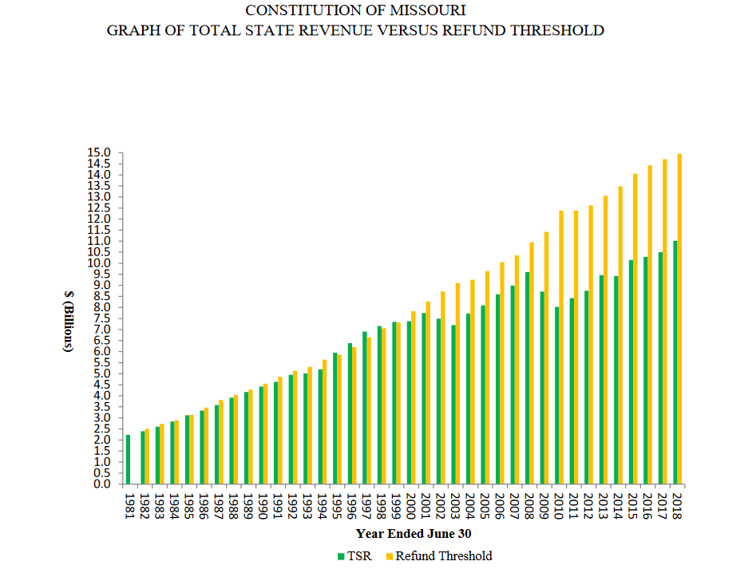
Revenues remain well below Hancock limits
The Hancock Amendment (1981) set a threshold on total tax revenue based on the personal income of Missourians
Threshold value of 5.64% has not been exceeded since 1998
Hancock Amendment also requires voter approvals of new taxes not in effect prior to 1981
Notes:
Source EPARC
This slide overlays significant enacted tax changes with the University of Missouri’s allocated appropriations. As noted on the chart, tax cut provisions appear to have an impact on the University’s overall trajectory of state support, setting the longer term trend line for the appropriations.
Hancock Amendment: Limits the amount of Missourian’s personal income that can be used to fund state government on a proportional basis. Therefore, no more than 5.6% of personal income (1981 level) can be used to fund state government. This can only be overridden with tax increases approved by popular vote.
Proposition C: Passed by popular vote, created a state-wide sales tax to fund K-12 education. The tax is distributed by the number of pupils in the district. Cut also mandated local property tax rollbacks amounting to half the increase from the sales tax.
SB 380: Capped federal and corporation tax deductions for state purposes and raised corporate income taxes by 25%. Not approved by popular vote, so triggered Hancock amendment in 1995-1999.
Exemptions of 2000: Increased amounts of taxpayer exemptions and allowed for additional deductions on state taxes.
SB 509: Decreases top marginal income tax rate from 6% to 5.5% over a period of years. In any year where state revenue grows by 150 million over the prior year, the rate will decrease by 0.1%.

Slide 5
Medicaid continues to grow
In 2019, Medicaid consumed 39% of Missouri’s budget. On a percentage basis, no other state spent more on Medicaid. (Source National Association of State Business Officers)

Slide 6
Missouri Ranks Last in Revenue per FTE Student Growth Since the Great Recession (through 2017)
Over this timeframe, Missouri ranks 50th in growth in tuition per student and 42nd in growth in state support per student.
Missouri was one of two states to see a decline in both state support and tuition.
From 2016 to 2017, Missouri saw the largest annual drop in total revenues per student at 8.4%.
Source: SHEEO
Notes:
Source: SHEEO
Decreases in constant dollar net tuition revenue per FTE should not be construed as being driven entirely by changes in tuition rates. Changes like more students at institutions with lower tuition and fees or fewer out-of-state students may also impact net tuition revenue.
Missouri Rankings (2016):
-44th in higher education support per capita
-40th in higher education support per $1,000 of personal income
-33rd in percentage of tax revenues allocated to higher education

Slide 7
Real Resources per Student has Changed in Proportion and is Declining
State Investment + Enrollment Growth
State Slow Decline + Enrollment Growth
State Slow Growth + Enrollment Maintenance
Shaded portions represent economic recession
Notes:
Similar trends exist on a per student basis from 1963-2000
However the trends since 2000 are exacerbated in state appropriations per student and muted on a growth basis in net tuition per student
Tuition growth per student has flattened significantly since 2005.
This has created an environment of falling real resources per student since 2000.

Slide 8
Higher Education continues to be crowded out
Downward adjustments have continued:
Missouri dropped higher education spend by 4.2% in FY 2018 and by 4.4% in FY 2019
Nationally, states increased higher education spending by 2.6% in FY 2018 and 3.5% in FY 2020
For FY2019, Missouri spent 4.2% of the state budget on higher education, compared to a national average of 10.1%
Missouri spends above average on K-12 education and Medicaid, and below average across all other categories
Notes:
Source NASBO: https://higherlogicdownload.s3.amazonaws.com/NASBO/9d2d2db1-c943-4f1b-b750-0fca152d64c2/UploadedImages/SER%20Archive/2019_State_Expenditure_Report-S.pdf

Slide 9
We have a RECURRING problem, not a one-time problem with a one-time solution
The pandemic only accelerated trends we are already experiencing

Slide 10
Enrollments have been falling for 5 years

Slide 11
The only significant revenue growth has come from healthcare
From 2016-2020:
Net tuition dropped $48M
State appropriations dropped $75M
Grants grew by $44M
Giving & Endowment income grew $30M

Slide 12
MU Experienced an Outsized Impact
From 2016-2020:
Net tuition dropped $71M
State appropriations dropped $36M
Grants grew by $22M
Giving & Endowment income grew $17M

Slide 13
Since the Pandemic…
Budgeted revenue decline of $115M over FY2019 in the academic enterprise
  State withholding and stabilization drops core by $55M
  Declining tuition and auxiliary revenues on declining enrollments
  Budget looks more like a recurring problem than a one-time problem
Additional exposure of $120M-$320M if further disruptions occur during FY2021
  Would not have to shut down campus again, could be driven by students slowing consumption
  Requires significant action to stem the resource consumption

Slide 14
Stimulus provided one-time support
$34 million from CARES direct institutional dollars
  $17M had to be issued as aid to students
  $17M covered costs of refunds and other shut down costs
Additional $49 million available from the state for costs to reopen
  Only for unbudgeted costs incurred from the pandemic
  Will help with one-time response
  But does not solve the recurring budget hole

Slide 15
Much of the action taken to date has been one-time, won’t fix recurring problem
The 4 Universities reported a $56M decrease in Supplies Services and Other Expense
The three categories above make up themajority of the savings

Slide 16
Current payroll actions will not generate recurring savings
Action | MU | UMKC | UMSL | S&T | System Admin | Total
Temporary Pay Decrease | 1,485 | 955 | 793 | 13 | 52 | 3,298
Short-Term Furlough (< 1 week) | 1,791 | 119 | 46 | 48 | 92 | 2,096
Long-Term Furlough | 259 | 9 | 107 | 30 | 3 | 408
Layoff | 151 | 38 | 57 | 34 | 24 | 304
Total | 3,686 | 1,121 | 1,003 | 125 | 171 | 6,106
One-time savings
The majority of realized savings from payroll are one time in nature
Only 5% of actions have permanently reduced workforce
Notes:
S&W Budget:
MU$790M

Slide 17
The Majority of Staff is not Central
Columbia
VCVP

Slide 18
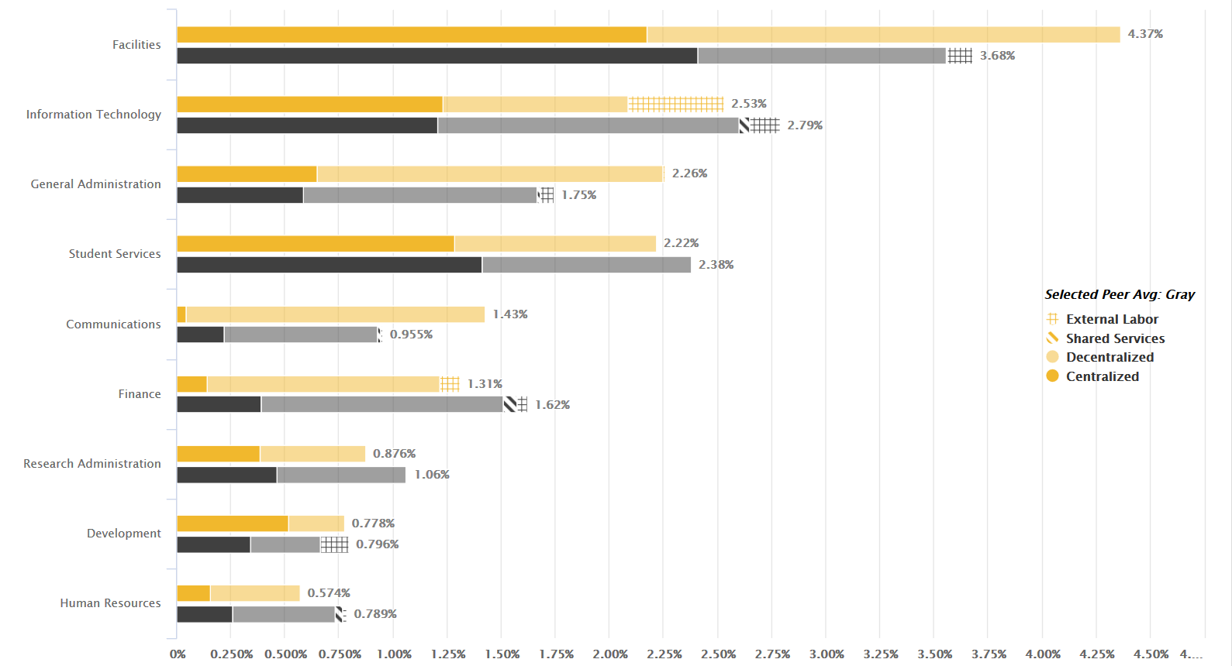
Areas of higher spend is generally driven by distributed/decentralized spend

Slide 19
Where do we go from here to solve our recurring problems?
Business as usual will not work and WE ALL have to be part of the solution

Slide 20
The System does not have resources
Investment income and State Appropriations currently allocated to System will be distributed equitably to campuses beginning in FY 22
System will provide administrative and compliance services at scale efficiently
System services will work as a cost center and each campus will be allocated an equitable share of the cost

Slide 21
The role of System will change
The System will shift to a cost center rather than a resource allocator
Provides services at scale
Regulation will need to change – less regulation as it relates to academic programs and the pursuit of mission
System can’t solve resource problems
  Allocated resources (State support, investment income, etc) are no longer available
  At best, state support will decline slightly or remain flat but will be more directed rather than broad based in the future

Slide 22
FY 20 Actions were only the beginning
The 12.5% cuts are likely to be maintained in many areas to deal with likely recurrence of state cuts
Investments that have revenue generation potential will be key to coming out of the crisis
Enrollment remains a key. Every 1% change in enrollment generates $2.7M in tuition revenue
Auxiliary revenues have a number of drivers other than enrollment – will be key to ensure they operate in financial sustainable ways.

Slide 23
Challenge to the University Remains
GROW REVENUE AND PRIORTIZE MISSION!
We can’t cut our way to greatness
  But we can spend our way to bankruptcy if revenues don’t change
  Necessary cuts are a result of the paradigm shift in revenues
Past growth strategies will not work
  State revenues will remain challenged, even with significant support we enjoy
  Traditional tuition rates and enrollments subject to market forces
New, paying students/learners and programs to serve them are the key to our future
Focus on productivity while growing… if we want the best faculty we need the paying students to support them
Administrative cost cutting can not solve the entirety of the shortfall

Slide 24
What do Academic Leaders need to do?
YOU control your destiny with revenues
  Enrollment
  Research
  Philanthropy
Think of spend in terms of resource generation and mission
Prioritize those activities that directly support teaching and research
Understand your budget and how it works – align incentives to how resources are produced
  market (what people demand)
  mission (how it relates to our core purpose)
  margin (how much money we make/consume on the activity)

Slide 25
Higher Education faces significant revenue risks
Citing the "incredible financial cost" associated with not fully reopening its campus this fall, UMass Amherst Chancellor Kumble Subbaswamy has calculated nearly $169 million in budget losses and is now placing 850 workers, including dining and residence hall staff, on indefinite furloughs effective Sept. 13
$67.4M in housing and dining revenue
$30.6M decline in tuition revenue
$20.9M reduction in grant and contract overhead income
$36.7M in 10% hold back for expected reductions in state support
$13M in virus testing, safety, isolation and quarantine measures
If MU faced a shortfall of $169M in revenue, what would that represent in terms of faculty and or staff positions that need to be considered for separation?
Average faculty salary and benefits = $83K + $27K = ~1,500 faculty positions
Average staff salary and benefits = $55K + $20K = ~2,200 staff positions

