Slide 1
Fiscal Year 2022 Finances
http://mubudget.missouri.edu

Slide 2
Fiscal Year 2022 Budget
FUNDING SOURCES
Operating Fund
Targeted Tuition & Student Fees
Restricted Appropriations
Grants & Contracts
Gifts, Endowment & Investment Income
Enterprise Operations
Total Revenue
618,496,443
120,808,373
25,035,310
233,886,143
118,647,655
1,815,663,735
$2,932,537,659
21.1%
4.1%
0.9%
8.0%
4.0%
61.9%
100%

Slide 3
“ENTERPRISE OPERATIONS”
Hospitals & Clinics
University Physicians
Athletics
Residential Life
University Stores
Research Reactor
Campus Dining
Veterinary Medicine
Enrollment Management
Agriculture
KOMU
Parking
Mizzou Academy
Other
$1,219,114,989
255,959,243
71,004,738
52,809,266
32,088,378
27,563,359
21,676,125
16,648,800
13,576,000
11,357,839
10,812,750
6,500,229
4,667,798
71,884,222
67.1%
14.1%
3.9%
2.9%
1.8%
1.5%
1.2%
0.9%
0.7%
0.6%
0.6%
0.4%
0.3%
4.0%
$1,815,663,735
100%

Slide 4
GENERAL OPERTAING SOURCES
Operating Fund
State Appropriations $222M
Tuition $355M
Indirect Cost $42M
Total $618M

Slide 5
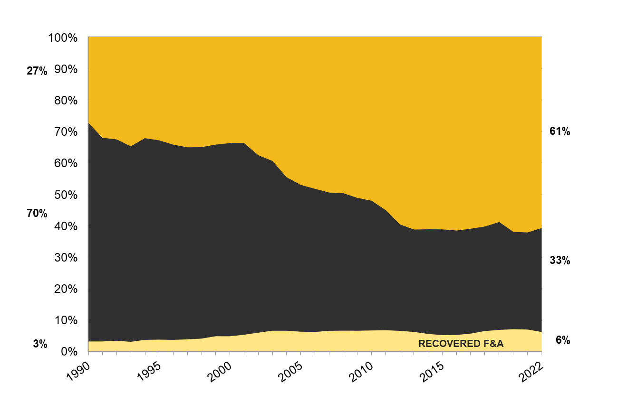
CHANGE IN GENERAL OPERATING FUNDING SOURCES
TUITION & SUPPLEMENTAL FEES
STATE SUPPORT

Slide 6
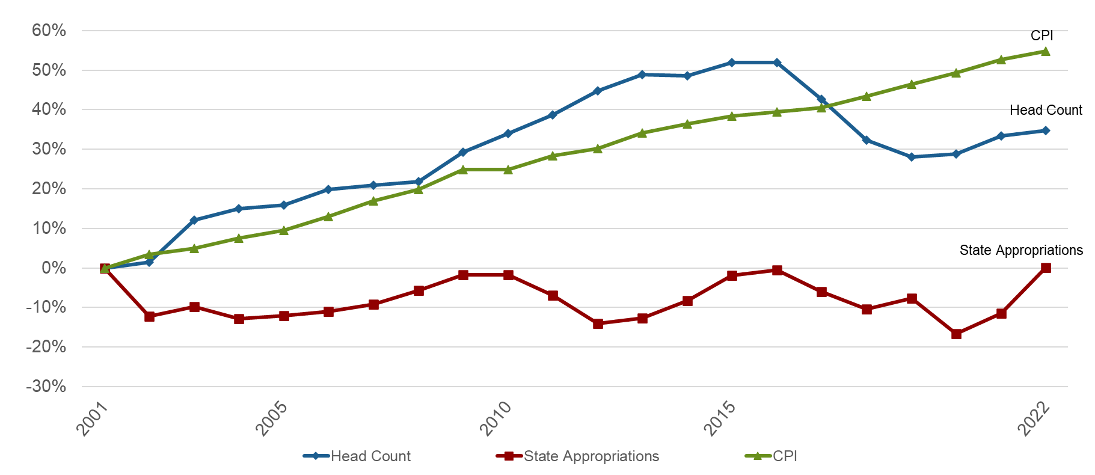
REVENUE DRIVERS
FY2001 – FY2022

Slide 7

STATE SUPPORT FOR HIGHER EDUCATION
Appropriation per Capita Ranking
29
7
13
21
46
30
18
40
14
*Information obtained from the Grapevine Report publish by Illinois State University, FY2021 National Comparison

Slide 8
TUITION & FEE COMPARISON
RESIDENT UNDERGRADUATE 2020-2021)
Combined Tuition & Fees
Institution Highest Lowest Average
AAU Public $19,679 $6,381 $12,756
AAU Public & Private $61,671 $6,381 $31,666
SEC Public $13,264 $6,381 $10,993
SEC Public & Private $54,158 $6,381 $14,076
Big Ten Public $18,450 $9,606 $12,892
Big Ten Public & Private $58,701 $9,606 $16,164
Big XII Public $11,688 $8,976 $10,460
Big XII Public & Private $51,660 $8,976 $18,459
University of Missouri – Columbia $10,723
Source: IPEDS Data Center

Slide 9
FY2021 STATE APPROPRIATIONS FOR HIGHER ED
PER CAPITA

Slide 10
FY2021 STATE APPROPRIATIONS FOR HIGHER ED
PER $1,000 IN PERSONAL INCOME

Slide 11
FUNDING PER STUDENT FTE
$23,979 2.63%
$110,640,836
$19,768 1.29%
$15,710

