Slide 1
Fiscal Year 2024 Finances
http://finance.missouri.edu

Slide 2
Fiscal Year 2024 Budget
FUNDING SOURCES
State Appropriations
Tuition & Fees
Targeted Appropriations & Fees
Grants & Contracts
Gifts, Endowment & Investment Income
Enterprise Operations
Total Revenue
251,382,518
522,210,001
58,312,357
373,748,381
137,210,796
2,156,098,589
$3,498,962,642
7.2%
14.9%
1.7%
10.7%
3.9%
61.6%
100%

Slide 3
“ENTERPRISE OPERATIONS”
Hospitals & Clinics
University Physicians
Athletics
Residential Life
Research Reactor
Veterinary Medicine
University Stores
Campus Dining
Agriculture
KOMU
Parking
Other (Revenue less than $5M)
$1,456,103,241
304,000,258
80,078,659
59,055,340
45,301,099
32,445,265
32,012,589
27,122,458
12,610,464
10,028,912
7,843,739
89,496,564
67.5%
14.1%
3.7%
2.7%
2.1%
1.5%
1.5%
1.3%
0.6%
0.5%
0.4%
4.2%
$2,156,098,589
100%

Slide 4
GENERAL OPERATING SOURCES
General Revenue Allocation - GRA
State Appropriations $251M
Tuition and Fees $522M
Overhead (F&A and Inst. Support) $75M
Total $848M

Slide 5
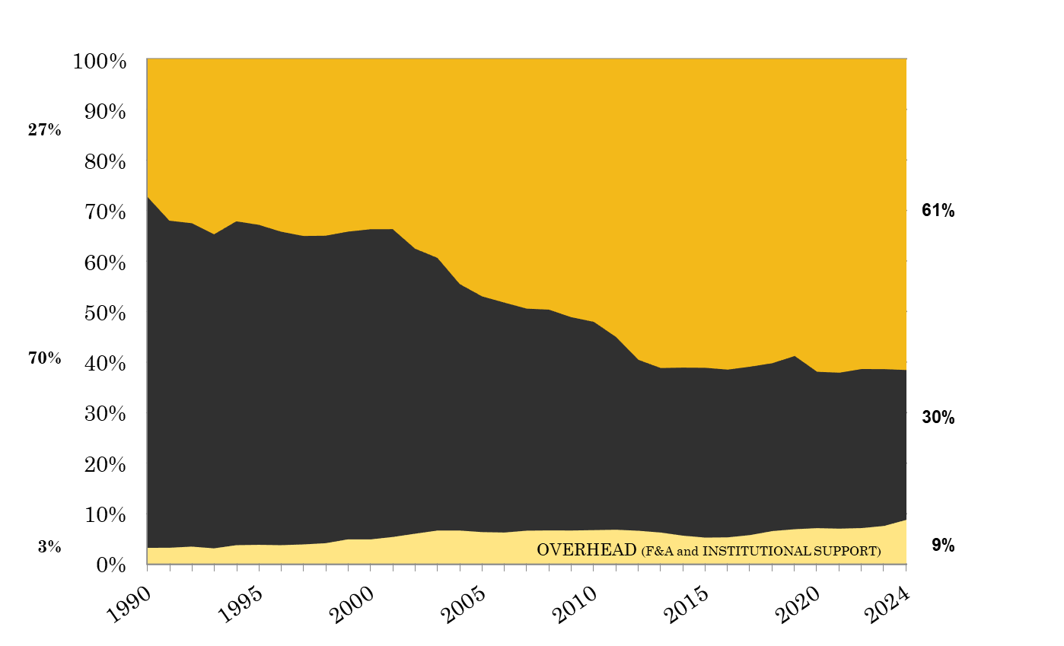
CHANGE IN GENERAL OPERATING FUNDING SOURCES
TUITION & FEES
STATE SUPPORT

Slide 6
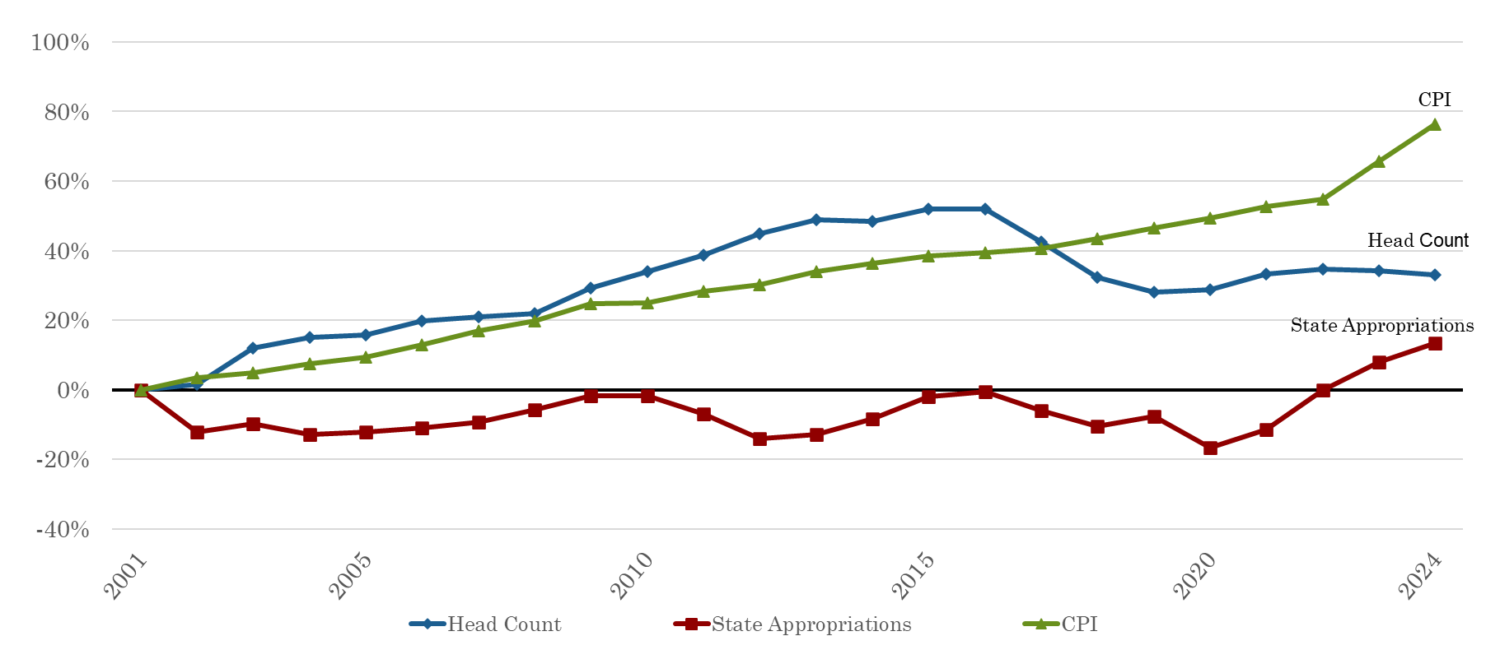
REVENUE DRIVERS
FY2001 – FY2024

Slide 7

STATE SUPPORT FOR HIGHER EDUCATION
Appropriation per Capita Ranking
35
9
11
19
45
24
15
40
16
*Information obtained from the Grapevine Report publish by Illinois State University, FY2023 National Comparison

Slide 8
TUITION
RESIDENT UNDERGRADUATE 2022-2023
Combined Tuition & Fees
Institution Highest Lowest Average
AAU Public $19,760 $4,477 $11,196
AAU Public & Private $63,804 $4,477 $32,527
SEC Public $12,288 $4,477 $9,466
SEC Public & Private $58,130 $4,477 $12,942
Big Ten Public $18,368 $7,770 $12,004
Big Ten Public & Private $62,391 $8,711 $15,603
Big XII Public $11,698 $4,478 $8,477
Big XII Public & Private $53,890 $4,478 $14,656
University of Missouri – Columbia $10,452
Source: IPEDS Data Center

Slide 9
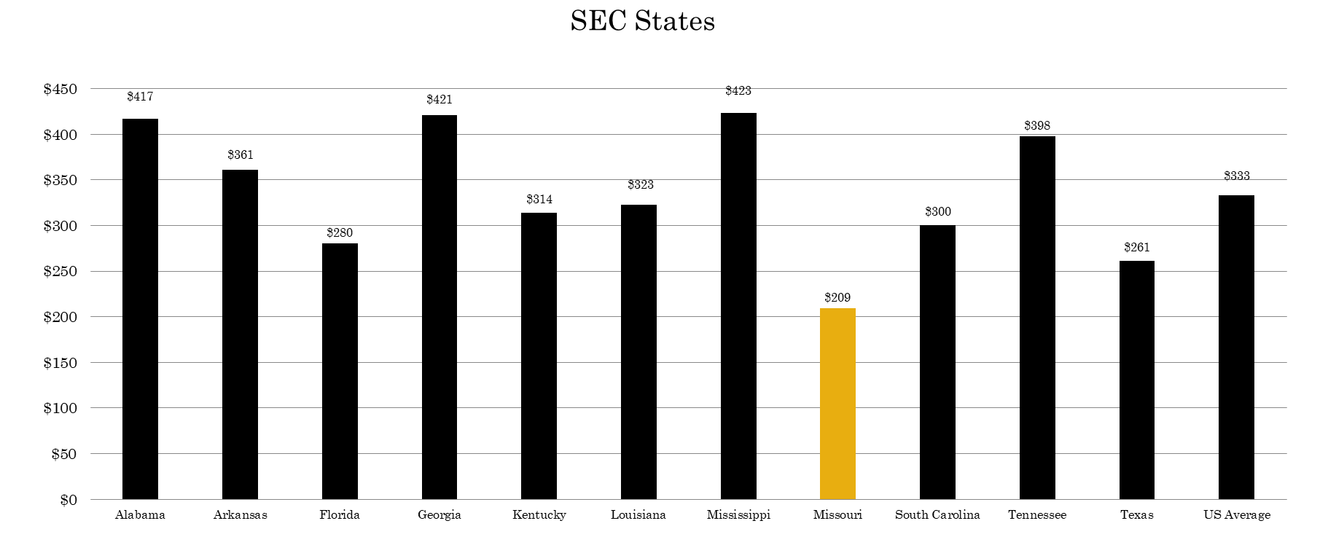
FY2023 STATE APPROPRIATIONS FOR HIGHER ED
PER CAPITA

Slide 10
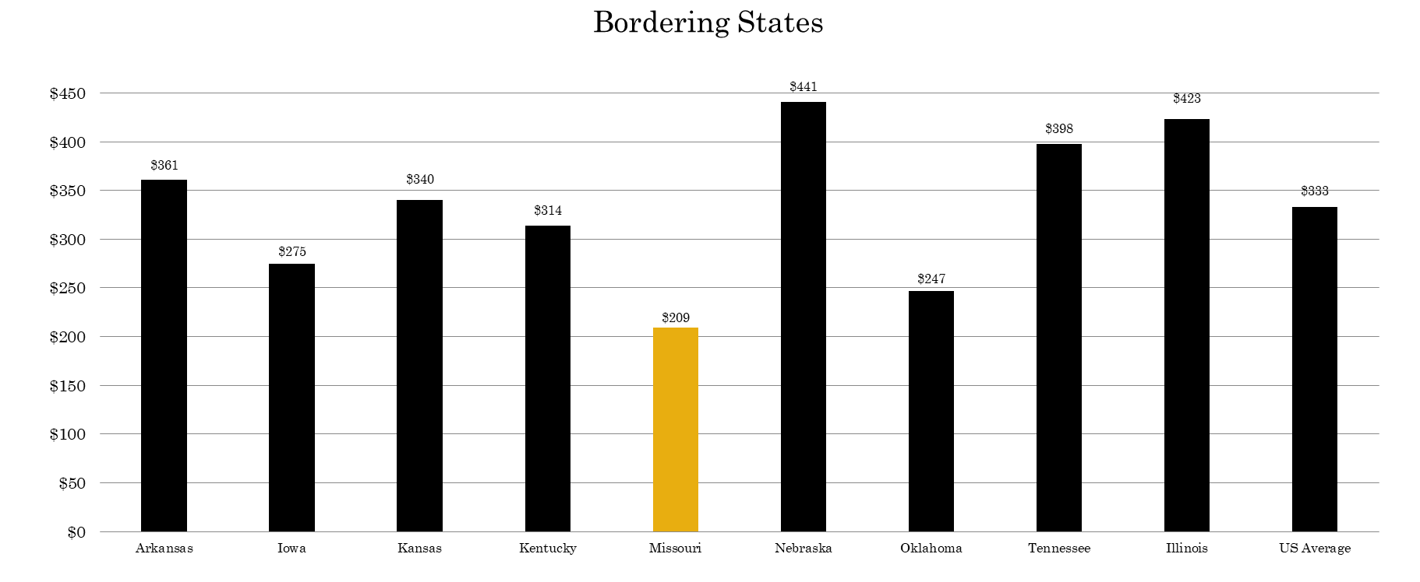
FY2023 STATE APPROPRIATIONS FOR HIGHER ED
PER CAPITA

Slide 11
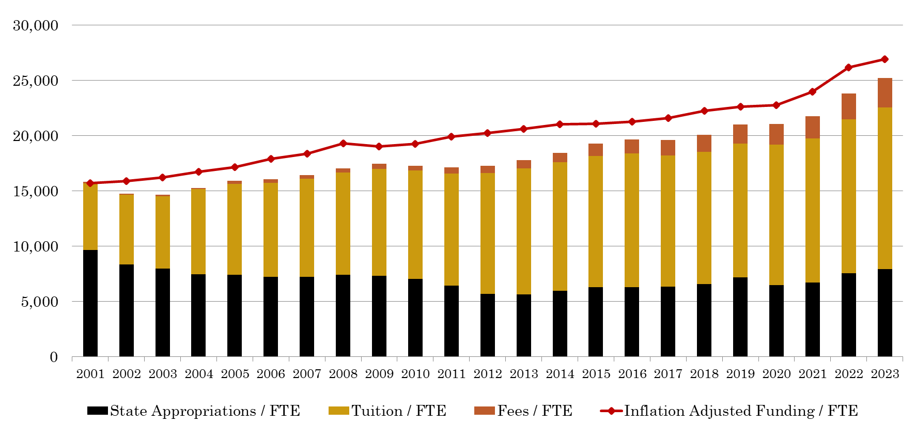
FUNDING PER STUDENT FTE
$26,927 3.25%
$46,326,612
$25,198 2.69%
$15,710

