Slide 1
Fiscal Year 2025 Finances
http://finance.missouri.edu

Slide 2
Fiscal Year 2025 Budget
FUNDING SOURCES
State Appropriations
Tuition & Fees
Targeted Appropriations & Fees
Grants & Contracts
Gifts, Endowment & Investment Income
Enterprise Operations
Total Revenue
260,082,427
593,044,932
114,192,256
498,343,058
153,974,410
2,712,638,471
$4,332,275,555
6.0%
13.7%
2.6%
11.5%
3.6%
62.6%
100%
Notes:
File: Budget Original Full Deck FY25_0705
CBUDG>FiscalYear>FY 2025> FY25 Presentations_Surveys

Slide 3
“ENTERPRISE OPERATIONS”
Hospitals & Clinics
University Physicians
Research Reactor
Athletics
Residential Life
Veterinary Medicine
Campus Dining
University Stores
KOMU
Parking
Other (Revenue less than $5M)
$1,851,736,106
382,664,980
125,341,000
92,494,823
61,777,915
31,292,797
28,649,605
28,216,298
11,900,000
9,870,440
88,694,507
68.3%
14.1%
4.6%
3.4%
2.3%
1.2%
1.1%
1.0%
0.4%
0.4%
3.3%
$2,712,638,471
100%
Notes:
File: Budget Original Full Deck FY25_0705
CBUDG>FiscalYear>FY 2025> FY25 Presentations_Surveys
Other = revenue sources that are individually less than $5M
Larger items:
Student funded insurance
Mizzou Rec Center
Student Health Center
Mizzou Academy
Assessment Resource Center
Adventure Club
Missouri Press
Outside revenues brought into all the research centers
International Center programs
Late payment fees and penalties
The Missourian Newspaper
KBIA
Marching Mizzou
Lots of small things:
Camps that are offered in numerous places
Conferences or short course offerings
Small operations unit specific apparel and goods
Study Abroad travel fees
Concerts and events

Slide 4
GENERAL OPERATING SOURCES
General Revenue Allocation - GRA
State Appropriations $259M
Tuition and Fees $591M
Overhead and F&A $91M
Total $941M
Notes:
File: Budget Original Full Deck FY25_0705
CBUDG>FiscalYear>FY 2025> FY25 Presentations_Surveys
$1,115,500 in State Appropriations and $2,084,932 in Tuition/Fees did not enter the GRA pool from revenue brought in due to one-time transfers and fees.
State Appropriations:
$970,000 – MU Adult Leadership Training targeting rural leaders and ag
$145,500 – MU Urban Gardening and Agriculture Extension Program
Tuition:
$1,352,251 – Student Fee Collection, C3101013
$450,000 – CBSGA CMIZZON elearning, C130013-Academic Technology
$282,681 – Other Education Fees in CCAMP

Slide 5
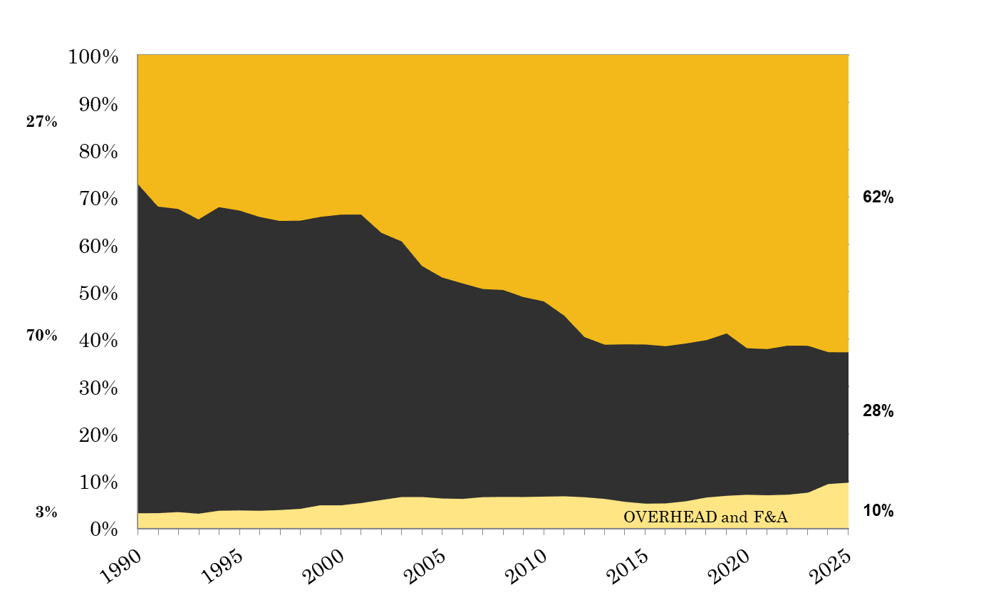
CHANGE IN GENERAL OPERATING FUNDING SOURCES
TUITION & FEES
STATE SUPPORT
Notes:
File: Budget Original Full Deck FY25_0705, Actuals as of 09/26/2024. 2025 Budget. This includes all years and appropriations and recovery for both UOEXT and COLUM.
CBUDG>FiscalYear>FY 2025> FY25 Presentations_Surveys
Three and a half decades.

Slide 6
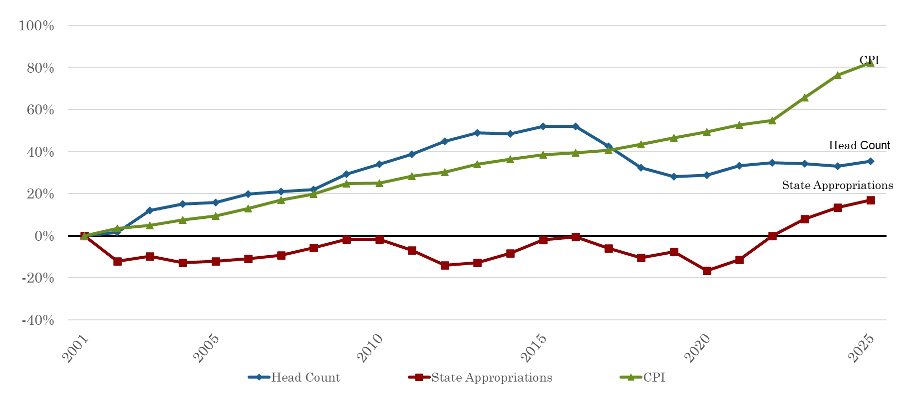
REVENUE DRIVERS
FY2001 – FY2025
Notes:
CPI increase 3.35% from FY23 to FY24.
Fall 24 census headcount 31,543

Slide 7

STATE SUPPORT FOR HIGHER EDUCATION
Appropriation per Capita Ranking
39
10
12
19
46
33
16
38
23
*Information obtained from the Grapevine Report publish by Illinois State University, FY2024 National Comparison
Notes:
File: SHEEO_Grapevine_FY24_Tables
CBUDG>FiscalYear>FY 2025> FY25 Presentations_Surveys>FY24 Grapevine
NEW HAMPSHIRE 50
PENNSYLVANIA 49
ARIZONA 48
VERMONT 47
MISSOURI 46
RHODE ISLAND 45
OHIO 44
COLORADO 43
MONTANA 42
MICHIGAN 41
DELAWARE 40
IOWA 39
OKLAHOMA 38
MAINE 37
OREGON 36
INDIANA 35
NEVADA 34
KENTUCKY 33
WISCONSIN 32
FLORIDA 31
WEST VIRGINIA 30
IDAHO 29
NEW YORK 28
NEW JERSEY 27
SOUTH CAROLINA 26
MINNESOTA 25
LOUISIANA 24
ARKANSAS 23
MASSACHUSETTS 22
SOUTH DAKOTA 21
WASHINGTON 20
KANSAS 19
VIRGINIA 18
MISSISSIPPI 17
TENNESSEE 16
GEORGIA 15
CONNECTICUT 14
ALABAMA 13
ILLINOIS 12
TEXAS 11
NEBRASKA 10
ALASKA 9
NORTH CAROLINA 8
MARYLAND 7
UTAH 6
CALIFORNIA 5
NORTH DAKOTA 4
HAWAII 3fasdf
NEW MEXICO 2
WYOMING 1

Slide 8
TUITION & FEE COMPARISON
RESIDENT UNDERGRADUATE 2023-2024
Combined Tuition & Fees
Institution Highest Lowest Average
AAU Public $21,524 $6,381 $13,586
AAU Public & Private $69,045 $6,381 $35,816
SEC Public $14,130 $6,381 $11,266
SEC Public & Private $63,946 $6,381 $14,558
Big Ten Public $20,234 $9,992 $13,979
Big Ten Public & Private $68,237 $9,992 $19,883
Big XII Public $16,430 $6,368 $10,313
Big XII Public & Private $57,220 $6,368 $11,226
University of Missouri – Columbia $14,130
Source: IPEDS Data Center
Notes:
File: IPEDS
CBUDG>FiscalYear>FY 2025>FY25 Presentations_Surveys>FY24 Grapevine

Slide 9
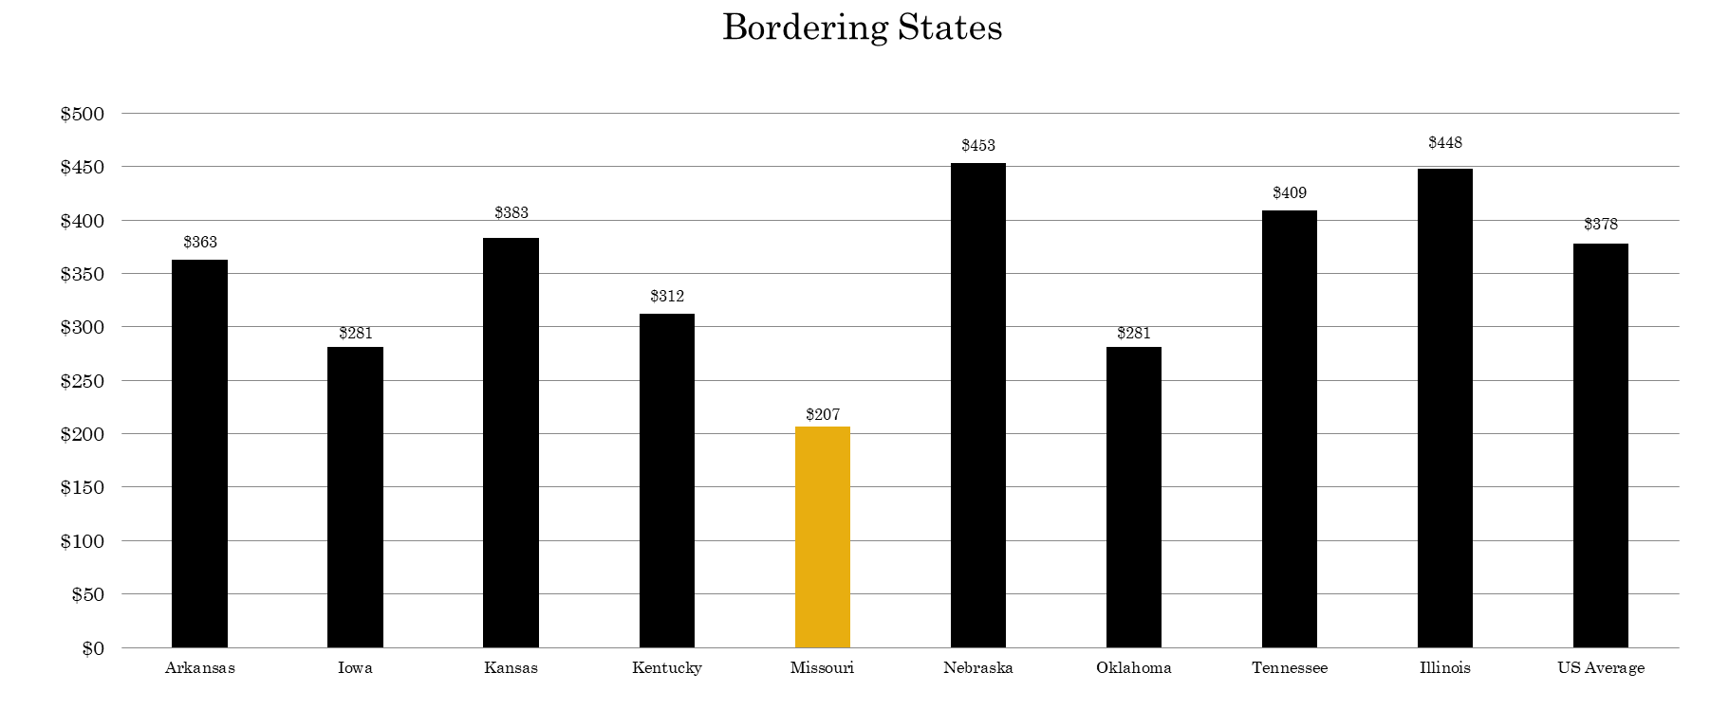
FY2024 STATE APPROPRIATIONS FOR HIGHER ED
PER CAPITA
Notes:
File: SHEEO_Grapevine_FY24_Tables
CBUDG>FiscalYear>FY 2025> FY25 Presentations_Surveys>FY24 Grapevine

Slide 10
FY2024 STATE APPROPRIATIONS FOR HIGHER ED
PER CAPITA
Notes:
File: SHEEO_Grapevine_FY24_Tables
CBUDG>FiscalYear>FY 2025> FY25 Presentations_Surveys>FY24 Grapevine

